Slide 1
Analysis & Predict Duration of taxi trip Based on Social Streaming & Geospatial data
Ziwei Fan

Slide 2
Outline
Introduction
Related works
Approach
Result
Future work
Reference

Slide 3


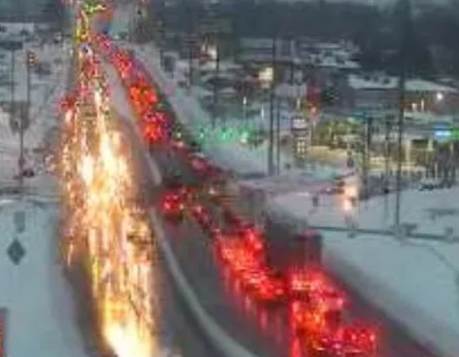
Introduction:
Taxi trip Analysis:
5:00-7:00
Geospatial Analysis: Number of Request VS. Time slot/Date?
Passenger
Predict the Total Ride Duration of taxi trips in NY
Weather-Traffic Analysis:
How will weather factor affect traffic?
pavement friction
lower visibility distance
Notes:
A. Taxi Trip analysis:
From the driver’s side:
I will build a model to predict the total ride duration based on historical records, such as pick and drop longitude, latitude.
From the driver’s:
What the hot areas for passenger to request taxi? And what the time slot? I will analysis based on geospatial data & time data.
The drivers could go to these areas during the exact time slot. It more likely they could have more passengers.
B. Weather-Traffic Analysis:
Is there any relationship between weather and duration?
(In rainy days, pavement friction goes down with the higher wetness, and lower visibility distance goes with the rainfall. Accordingly, it is more likely that these aspects will affect the performance of the drivers. The duration will go with these aspects.)

Slide 4

Related Work:
Taxi trip Analysis-1:
Visualization-Geospatial Hot Area
Bokeh
Folium
Geo Information
Animation
Data
Processing
Geo-Distributions
Geo-Image processing
Improper data?
Outlier?
Timestamp?
Interactive visualization library to target web browsers
Interactive
in nature &
Real map
Number of Request
VS. Time slot/Date/Location?

Slide 5
Related Work:
Taxi trip Analysis-2:
Prediction
PCA
TPOT
Data
Process
Extract Features
Look for best Pipeline
Make predictions
XGBoost? AdaBoost?
RandomForestRegressor?
Improper data?
Outlier?
Timestamp?
Preferred?
Removed?
Predicts the Total Ride Duration of taxi trips in NY
Notes:
Data process:
handle with improper data,
pick out the outlier,
unify the timestamp.
Extract features-PCA:
Find out what dimension preferred and which dimension should be removed? Apply dimensionality reduction by PCA.
Look for best Pipeline-TPOT:
Split the data to train and validate
Look for the best pipeline: XGBoost/adaboost?
Make prediction by selected pipeline.

Slide 6

Related Work:
Weather-Traffic Analysis:
Data
Processing
Streaming
Feature
Extraction
Data
Visualization
Social Stream
Analysis
Find correlation
What weather factor will affect traffic?

Slide 7
Approach
Taxi trip
Weather-Traffic
Data Processing
Geo information Distribution: Bokeh
Geospatial graph processing: Folium
Feature Extraction: PCA
K Fold Cross validation
Look for best pipeline: TPOT
Heat map Correlation
Pearson Correlation
Media Stream Analysis
Notes:
PCA: Principal Component Analysis (PCA) to apply dimensionality reduction. Which features should be preferred and which ones should be removed from a high dimensional feature vector?
Mini-batch K means: uses mini-batches to optimize the same objective function, while is to reduce the computation time.
TPOT is an Automated Machine Learning tool that optimizes machine learning pipelines using genetic programming. It could explore thousands of possible pipelines to find the best one for the data.
Animation of cab pickups: Plot the heatmap and make an animation of pickup and see how the traffic changes with hours.
Heat map Correlation: Check how the features are correlated. Assign a different color for different count range.

Slide 8
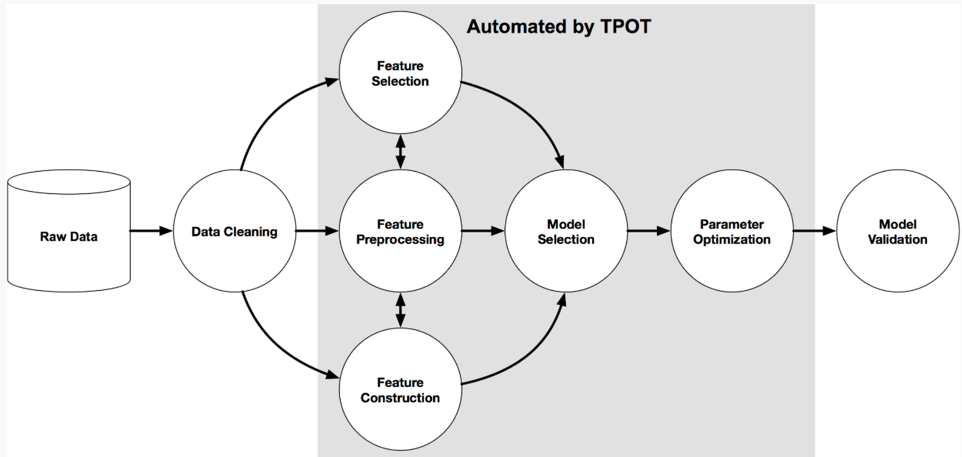
TPOT
Approach-TPOT
This is obviously a huge issue:
when machine learning is supposed to allow machines to learn on their own.
The sequences of steps that turn the raw data into a predictive model…

Slide 9
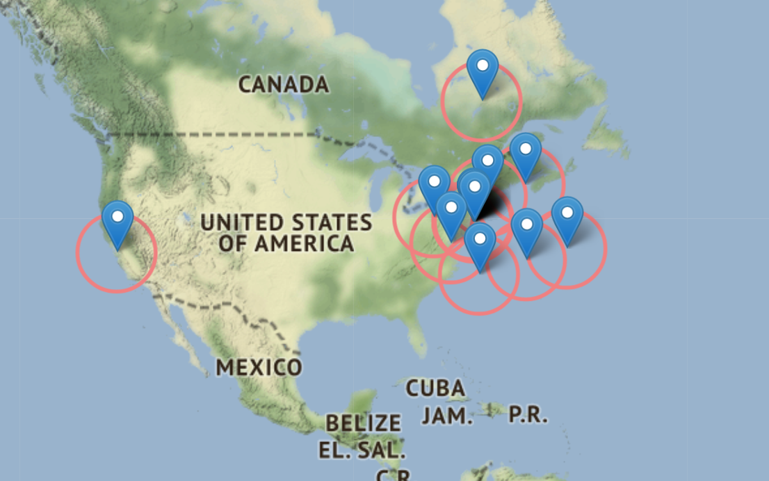
Approach-Folium:
This package offers geographical-maps with a different kind of terrains for maps
Bubble at the location
Scroll the plot
Shift the zoom

Slide 10
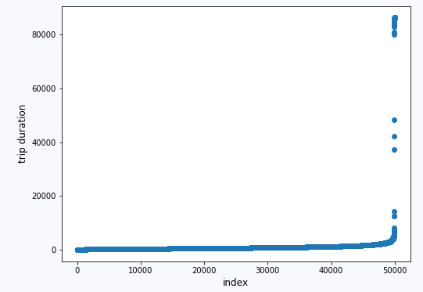
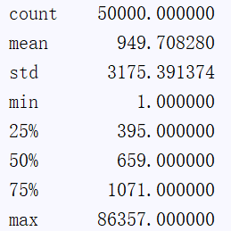
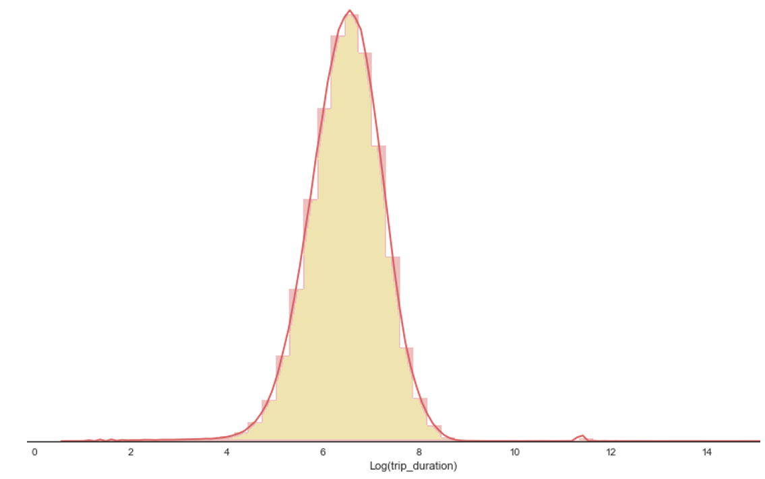
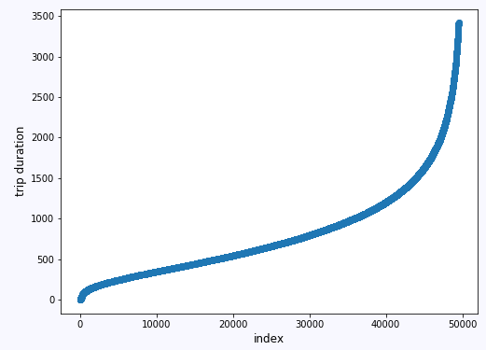
Result
Outlier
Preprocess
Distribution plot:
Feature Extract
Notes:
Outlier:
trainDF.trip_duration.quantile(0.99)

Slide 11
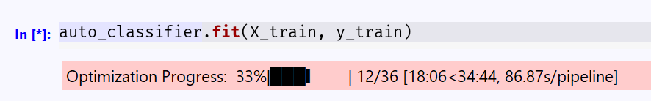
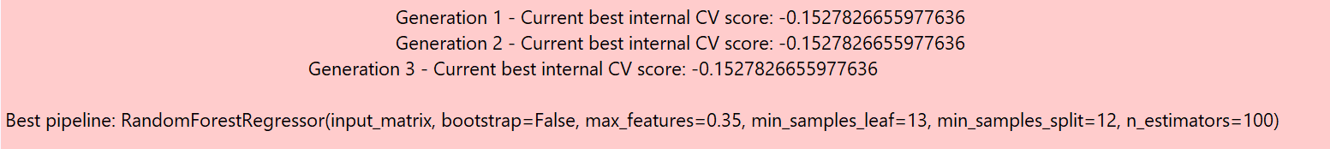
Result
TPOT

Slide 12

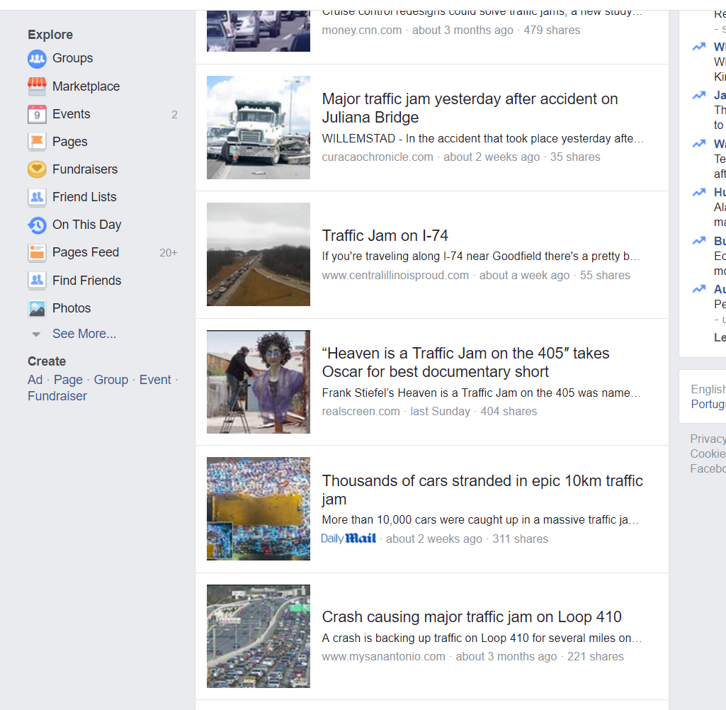
Future work
Validation on TPOT
Merge with Real Map--Folium
Social Streaming Analysis

Slide 13
Reference
[1] TPOT: http://epistasislab.github.io/tpot/
[2] What Is K-Fold Cross Validation? https://magoosh.com/data-science/2017/12/08/k-fold-cross-validation/
[3] 3.3. Model evaluation: quantifying the quality of predictions: http://scikitlearn.org/stable/modules/model_evaluation.html#accuracy-score
[4] XGBoost Guidance:
https://xgboost.readthedocs.io/en/latest/build.html#building-on-windows
[5]Clustering-Mini Batches K-means:
http://scikit-learn.org/stable/modules/clustering.html#mini-batch-kmeans
[6] PCA for Data Visualization:
https://towardsdatascience.com/pca-using-python-scikit-learn-e653f8989e60
[7] TPOT: A Python tool for automating data science http://www.randalolson.com/2016/05/08/tpot-a-python-tool-for-automating-data-science/

